Slide 2
ABSTRACT
Crime analysis and prevention is a systematic approach for identifying and analyzing patterns and trends in crime. By using the concept of Data Mining, we can extract previously unknown useful information from an unstructured data.
Supervised learning uses data sets to train, test and get desired results on them whereas Unsupervised learning divides an inconsistent, unstructured data into classes or clusters.
Decision trees, Naive Bayes and Regression are some of the supervised learning methods in data mining and machine learning on previously collected data and thus used for predicting.
With the increasing advent of computerized systems, crime data analysts can help the Law enforcement officers to speed up the process of solving crimes.
Even though we cannot predict who all may be the victims of crime but can predict the place that has probability for its occurrence.
This system can also be used for any crime departments for reducing the crime and solving the crimes with less time.

Slide 3
AIM OF THE PROJECT
Aim of the project :
The aim of this project is to analyze and predict the crime rate that helps the investigator or police to solve the crime problems from the huge amount of information that is stored in database.
Data visualization is also used to represent the output in the forms of images and charts.
Scope of the project:
The scope of the project is to prevent crimes or control the crime activities which may occur in the future.

Slide 4
INTRODUCTION
Crime is a violation of humanity, often punishable by law. Criminology is a study of crime, interdisciplinary science that investigates and investigates crime and criminal performance data.
Criminal activity is now high and the police department is responsible for controlling and reducing criminal activity. There has been tremendous increase in machine learning algorithms that have made crime prediction feasible based on past data.
The aim of this project is to perform analysis and prediction of crimes in states using machine learning models. It focuses on creating a model that can help to detect the number of crimes by its type in a particular state.
In this project various machine learning models like linear regression, boosted decision trees will be used to predict crimes. Various visualization techniques and plots are used which can help law enforcement agencies to detect and predict crimes with higher accuracy.
This will indirectly help reduce the rates of crimes and can help to improve securities in such required areas.

Slide 5
LITERATURE REVIEW
Mehmet Sait and Mustafa Gok ,2017, "Criminal prediction using Naïve Bayes theory" Springer 28.9: 2581-2592
The criminal prediction for finding the most probable criminal of a particular offense incident when the suspected list of offenders are provided with the criminal data which is generated synthetically using Gaussian Mixture Model. The authors used Naïve Bayes Classifier and Decision tree for offender prediction method and compared its performance.
Retnowardhani, Triana YS,2018, "Classify interval range of crime forecasting for crime prevention decision making", IEEE, (pp. 1-6).
Developed CreP-DSS web-based decision support system in PHP that supports law enforcement agency to control and support decision-making tasks for crime prevention. It splits the interval range for predicted crime trend, based on a level of offense for better decision-making to prevent crime.

Slide 6
DESIGN AND METHODOLOGIES
Data collection
Data Collection is one of the most important tasks in building a machine learning model. We collect the specific dataset based on requirements from internet. The dataset contains some unwanted data also. So first we need to pre-process the data and obtain perfect data set for algorithm.
Pre-Processing
It is the gathering of task related information based on some targeted variables to analyze and produce some valuable outcome. However, some of the data may be noisy, i.e. may contain inaccurate values, incomplete values or incorrect values. Hence, it is must to process the data before analysing it and coming to the results. Data pre processing can be done by data cleaning, data transformation, data selection.

Slide 7
DESIGN AND METHODOLOGIES
Data Mining Techniques
Data Collection is one of the most important tasks in building a machine learning model. We collect the specific dataset based on requirements from internet. The dataset contains some unwanted data also. So first we need to pre-process the data and obtain perfect data set r algorithm.
Linear regression:
Linear regression is one of the regression models where the variables dependent is either binary is categorical. It cannot handle continuous data.
Decision Trees:
The decision tree was built to predict the target column, after splitting the dataset into random training and test sets. The splitting criterion 'Entropy' was decided upon for splitting the dataset.

Slide 8
DESIGN AND METHODOLOGIES
Random Forest Classifier:
Random Forests Classifiers correct the decision trees' habit of overfitting the training dataset. It constructs multiple trees at the training time and outputs a mean prediction in regression and mode prediction in classification of data set.
Data Visualization
After implementing all scikit learn models. We will use matplotlib library to some data visualization and analysis of crime which are represented in graphs and piecharts.

Slide 9
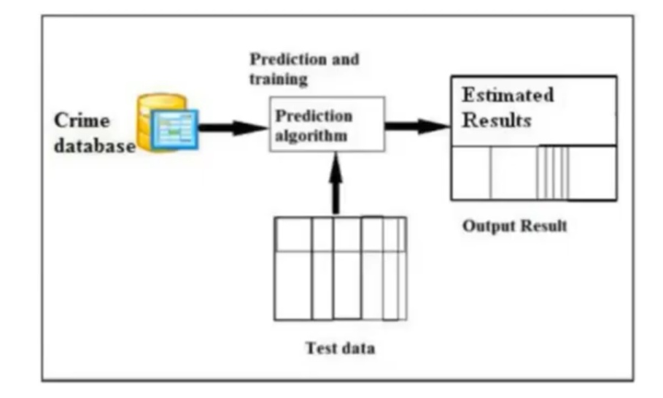
IMPLEMENTATION
Architecture Diagram

Slide 10
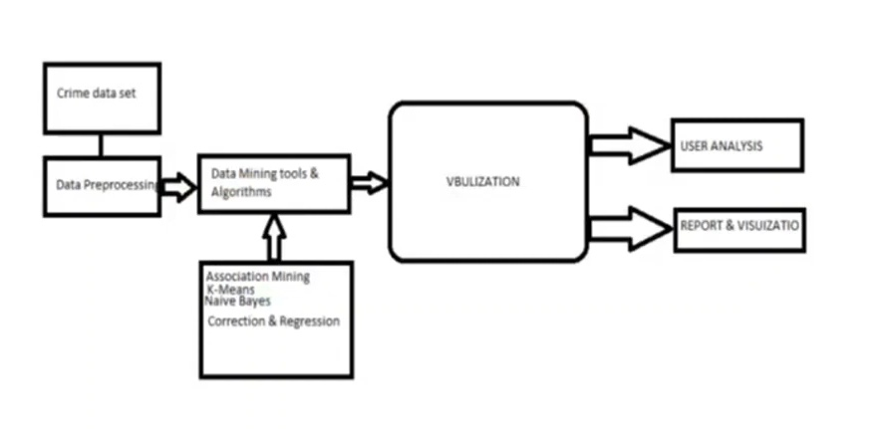
IMPLEMENTATION
Dataflow Diagram

Slide 11
CONCLUSION
In this system, we get to classify and cluster to improve the accuracy oflocation and pattern-based crimes. From the clustered results it is easy to identify crime prone areas and can be used to design precaution methods for future.
The classification of data is mainly used to distinguish types of preventive measures to be used for each crime.
Different crimes require different treatment and it can be achieved easily using this application.

Slide 12
FUTURE ENHANCEMENTS
From the encouraging results, we believe that crime data mining has a promising future for increasing the effectiveness and efficiency of criminal and intelligence analysis.
Visual and intuitive criminal and intelligence investigation techniques can be developed for crime pattern.
As we have applied clustering technique of data mining for crime analysis we can also perform other techniques of data mining such as classification.
Also we can perform analysis on various dataset such as enterprise survey dataset, poverty dataset, aid effectiveness dataset, etc.

